Slide 1
Origin of Species
Barriers to reproduction between species
Modes of speciation: allopatric, sympatric, parapatric
Hybrid zones
Genetics of speciation
Reading: Chapter 24 (all)
Suggested problems: 1-6

Slide 2
Macroevolution
The origin of new taxonomic groups (new sp., genera, families, kingdoms)
Speciation
1. Anagenesis
-transformation of a
species into another
2. Cladogenesis
-branching evolution

Slide 3
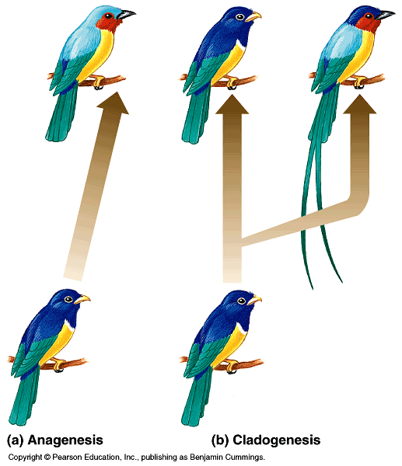
Two patterns of speciation

Slide 4
What is a species?
Compare:
Morphology
Physiology
Biochemistry
DNA
The biological species concept defines species as members of populations that actually or potentially interbreed in nature and produce viable offspring. (But do not produce viable, fertile offspring
with members of other groups.)
-Ernst Mayr 1942 (Systematics and the origin of species)

Slide 5
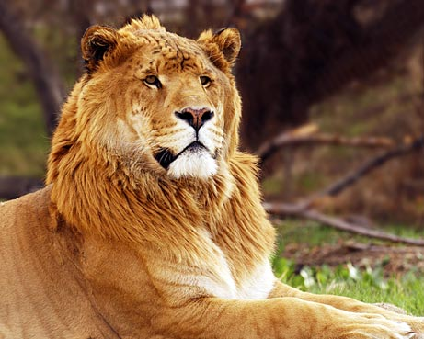
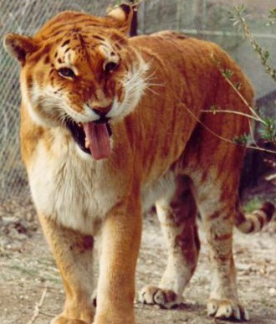
The BSC isn’t a perfect definition…..
Liger
(male lion x female tiger)
Tigon
(female lion x male tiger)

Slide 6
The formation of new species requires Reproductive Isolation
reproductive isolation: biological barriers that impede production
of viable, fertile offspring
Reproductive isolation blocks gene flow between different species*
ISOLATE THE GENE POOL!

Slide 7
Types of barriers to gene flow: 1. prezygotic (block fertilization)
Function by:
Impeding mating
Preventing the successful completion of an attempted mating
Hindering fertilization if mating is successful

Slide 8
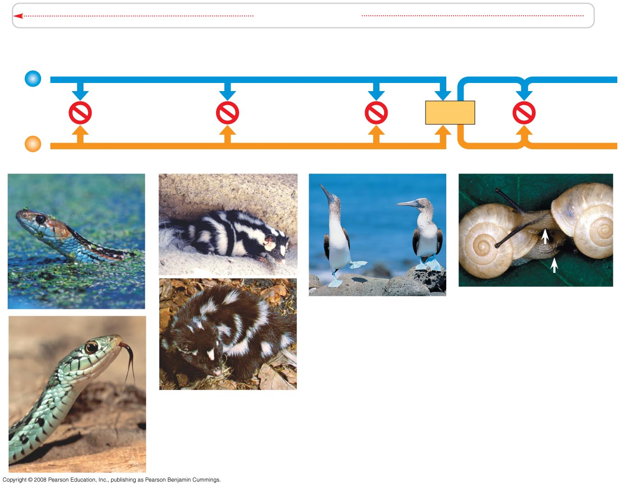
Examples of prezygotic barriers that impede mating
Habitat Isolation
Temporal Isolation
Behavioral Isolation
Individuals
of
different
species
(a)
(c)
(e)
(d)
(b)
Fig. 24-4a

Slide 9
Example of a prezygotic barrier that prevents completion of mating
Mechanical Isolation

Slide 10
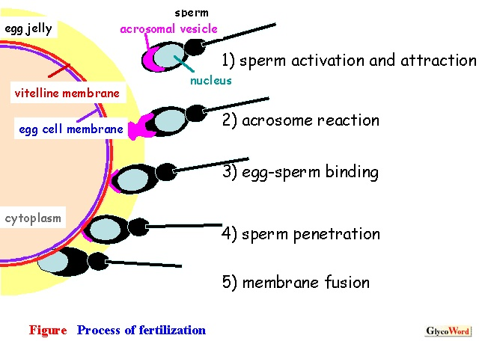
Example of a prezygotic barrier that prevents fertilization
Proteins on the sperm and in the egg jelly must bind to induce the acrosome reaction (ex: sea urchins)

Slide 11
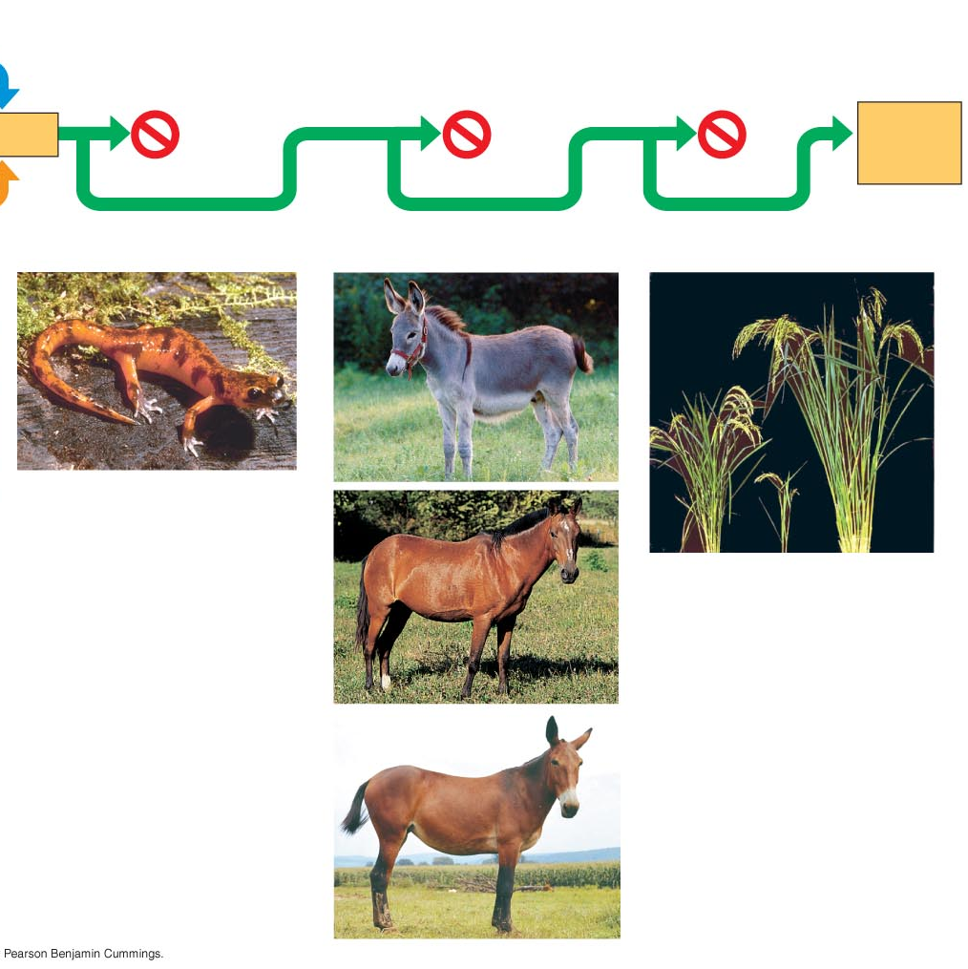
Types of barriers to gene flow: 2. postzygotic (reduce success of hybrid)
Reduced Hybrid Viability
Reduced Hybrid Fertility
Hybrid Breakdown
Fertilization
Viable,
fertile
offspring
(h)
(i)
(l)
(j)
(k)
Fig. 24-4i

Slide 12
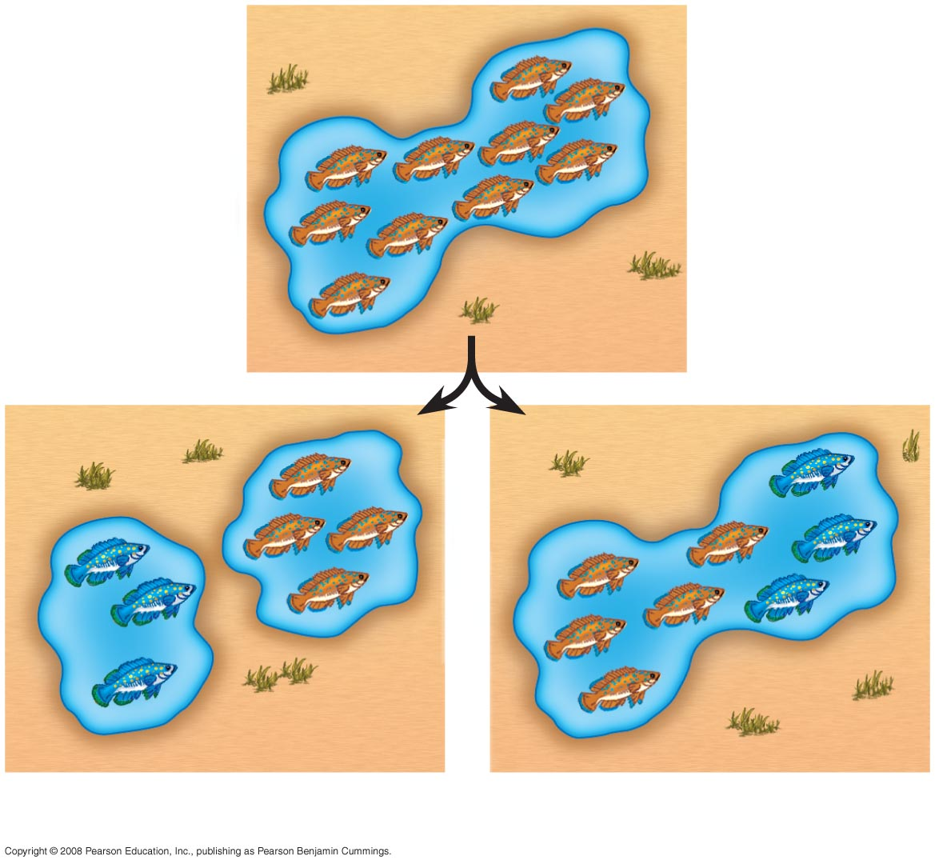
How do blocks to gene flow arise, leading to speciation?
Fig. 24-5
(a) Allopatric speciation
(b) Sympatric speciation
Subpopulations are isolated
geographically
Gene pools diverge (mutation,
natural selection, genetic drift - allele
frequencies change)
Less common
Gene flow reduced by polyploidy,
habitat, differentiation, sexual
selection

Slide 13
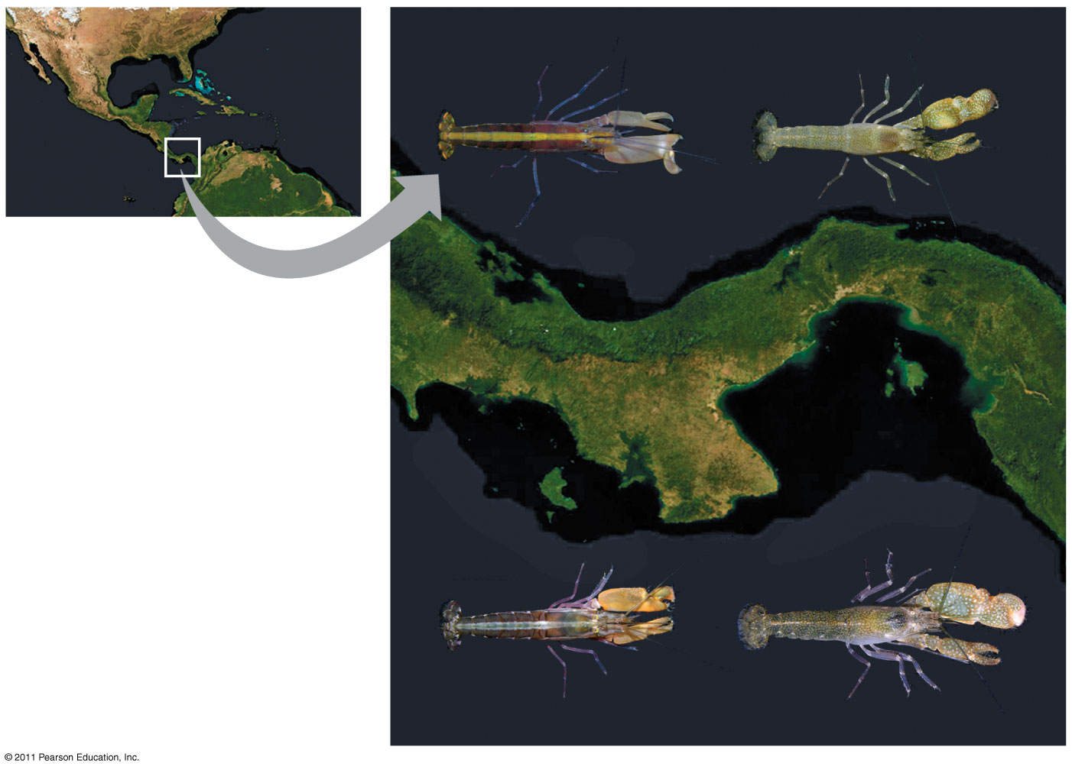
Examples of geographic barriers in allopatric speciation
(note: strength of barrier depends on species)
A. formosus
A. nuttingi
Atlantic Ocean
Geographic remodeling:
canyons, rivers, mountains,
changing water levels, etc
Isthmus of Panama
Pacific Ocean
A. panamensis
A. millsae
Ex: snapping shrimp on either side of the isthmus of Panama

Slide 14
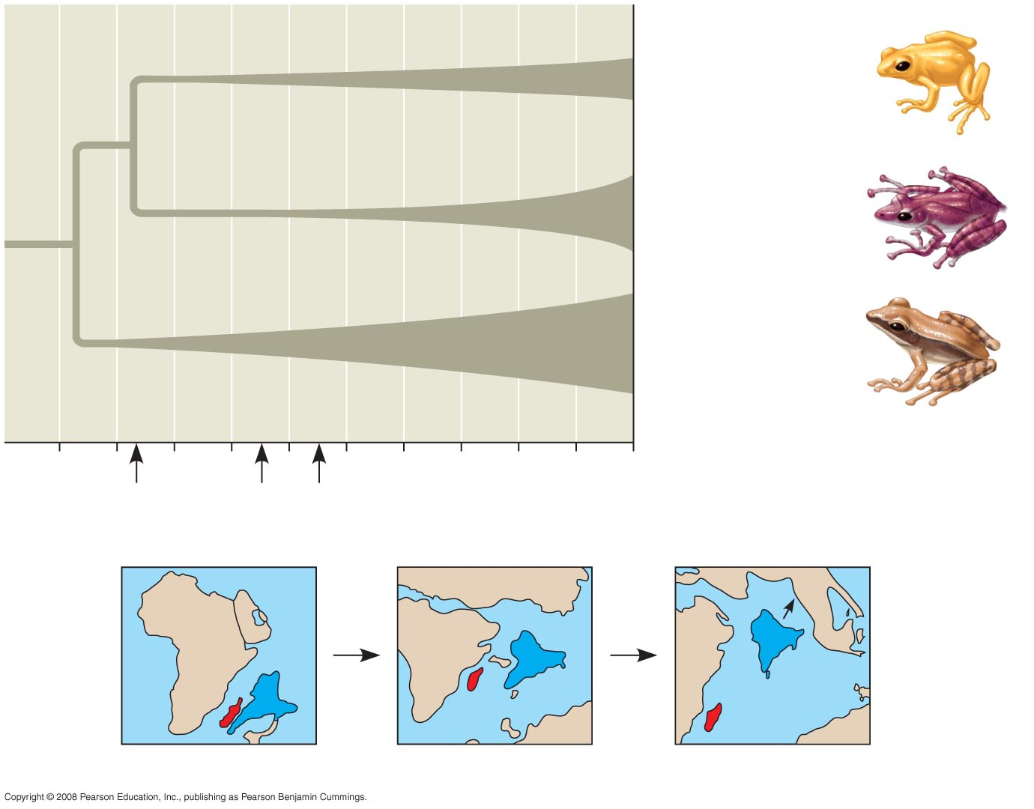
Mantellinae
(Madagascar only):
100 species
Rhacophorinae
(India/Southeast
Asia): 310 species
Other Indian/
Southeast Asian
frogs
100
80
60
40
20
0
1
2
3
Fig. 24-7
Millions of years ago (mya)
1
2
3
India
Madagascar
88 mya
65 mya
56 mya

Slide 15
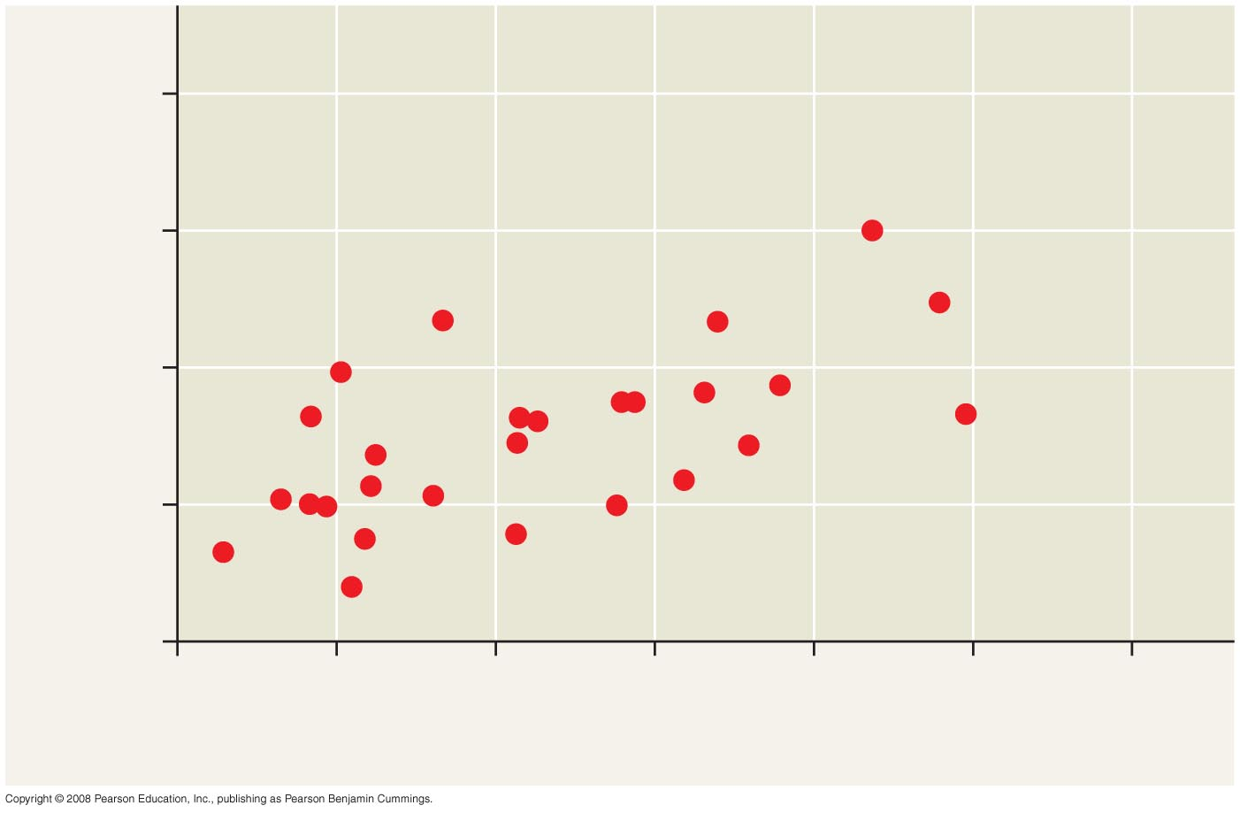
Distance alone may be a significant geographic barrier to gene flow
Reproductive isolation in different populations of dusky salamanders
2.0
1.5
Degree of reproductive isolation
1.0
0.5
0
0
50
100
150
200
250
300
Fig. 24-8
Geographic distance (km)
Long distance gene flow is not happening

Slide 16
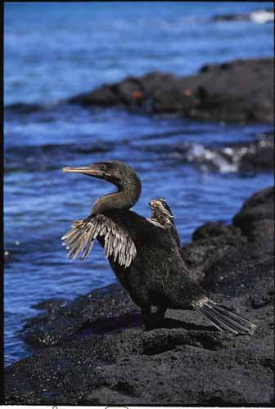
Some populations become isolated when descendents are unable to rejoin ancestral population
Ex: Flightless cormorants on the Galapagos Islands cannot return to South America to interbreed with flying cormorant populations

Slide 17
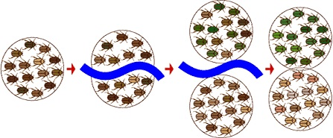
REMEMBER: Genetic variation must exist or arise between separated populations for speciation to occur

Slide 18
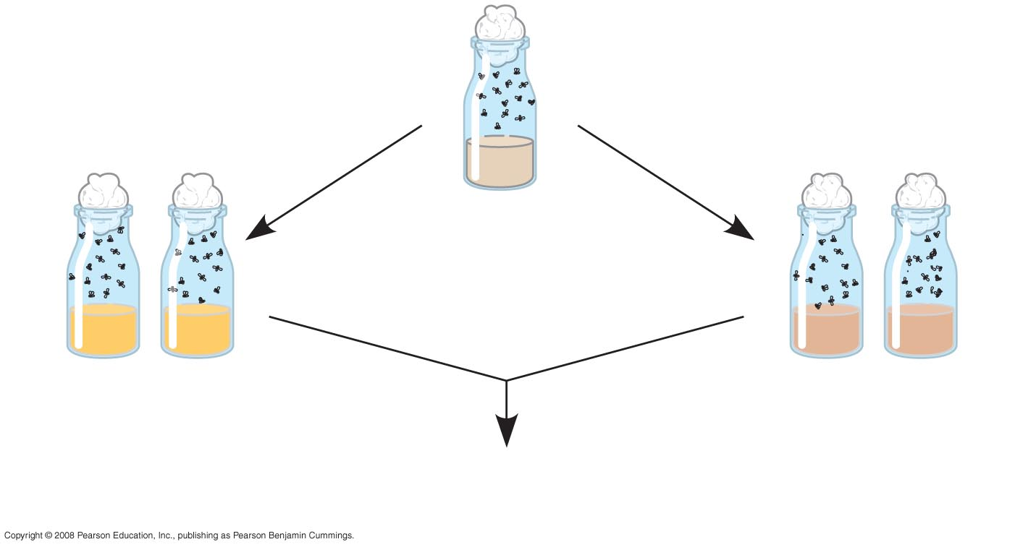
Observing allopatric speciation in the lab
1. Two “allopatric” populations of Drosophila pseudoobscura were created
EXPERIMENT
Fig. 24-9a
Initial population
Some flies
raised on
starch medium
Some flies
raised on
maltose medium
Mating experiments
after 40 generations

Slide 19

Results: After 40 generations, natural selection had altered the two populations enough that reproductive isolation had begun based on breeding preferences
RESULTS
Fig. 24-9b
Female
Female
Starch
Starch
Starch
Maltose
population 1
population 2
population 1
Starch
Starch
22
9
18
15
Male
Male
Maltose
8
20
12
15
population 2
Starch
Mating frequencies
in experimental group
Mating frequencies
in control group

Slide 20
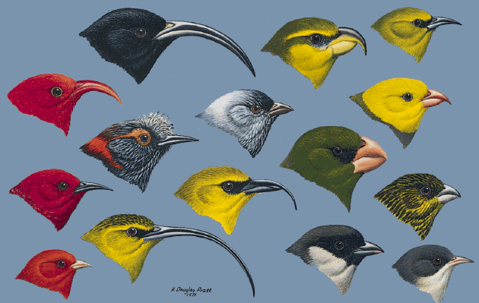
Adaptive Radiation as a result of allopatric speciation

Slide 21
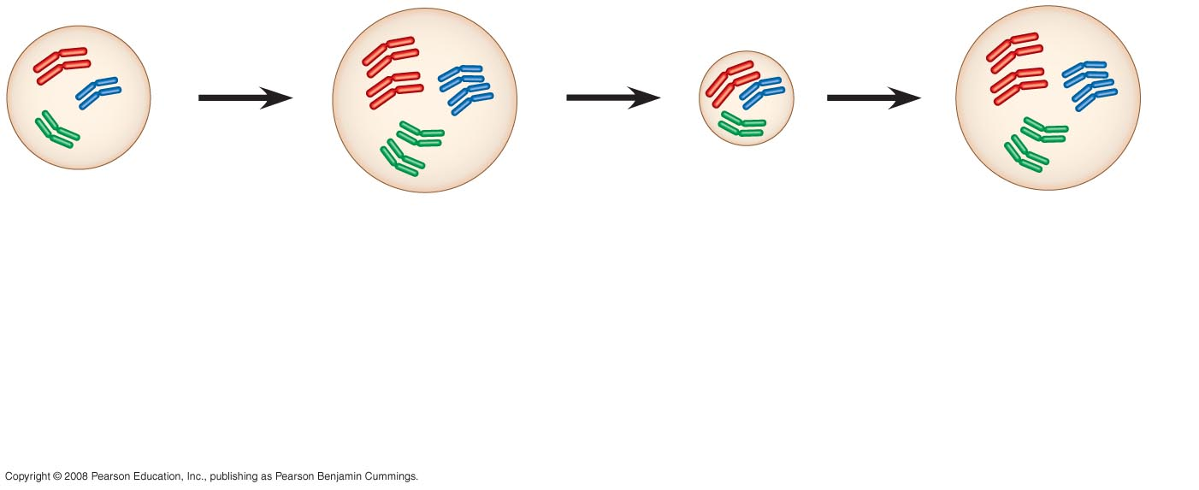
Several mechanisms can lead to sympatric speciation:
Polyploidy (extra set of chromosomes)
Autopolyploidy – more than 2 chromosome sets all derived
from same species
2n = 6
4n = 12
2n
4n
Failure of cell
division after
chromosome
duplication gives
rise to tetraploid
tissue.
Gametes
produced
are diploid..
Offspring with
tetraploid
karyotypes may
be viable and
fertile.
Fig. 24-10-3
Self-pollinate or mate with other tetraploids – reproductive isolation
without geographic separation

Slide 22
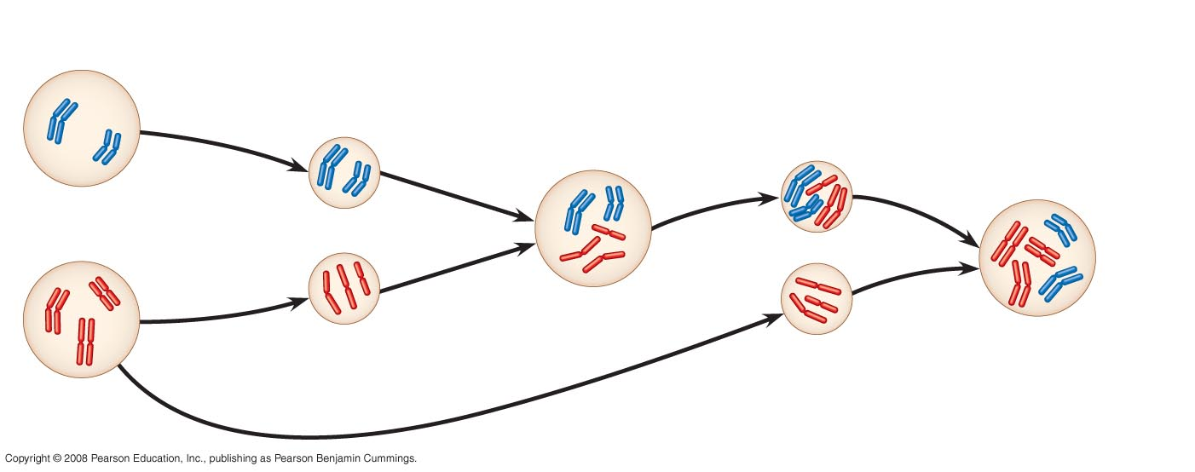
Allopolyploidy:
Fertile with each other, but cannot mate with either parent
More common in plants
Species B
2n = 4
Unreduced
gamete
with 4
chromosomes
Fig. 24-11-4
Unreduced
gamete
with 7
chromosomes
Hybrid
with 7
chromosomes
Meiotic
error
Normal
gamete
n = 3
Viable fertile
hybrid
(allopolyploid)
2n = 10
Normal
gamete
n = 3
Species A
2n = 6

Slide 23
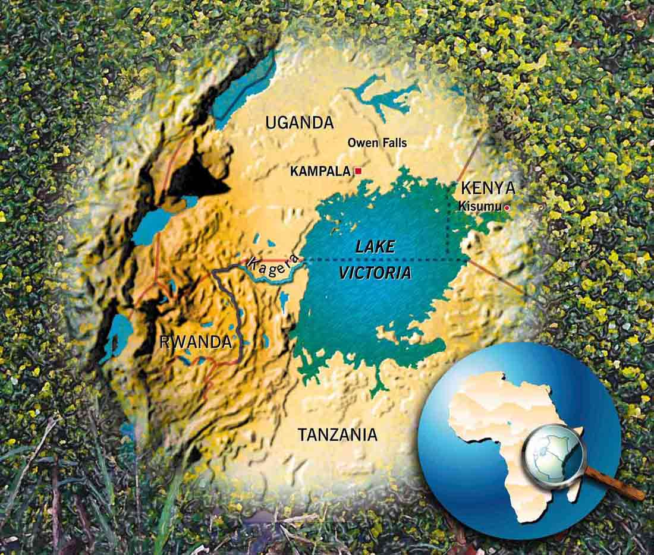
Several mechanisms can lead to sympatric speciation: sexual selection
Ex: certain species of cichlids in Lake Victoria (East Africa)
contains hundreds of species derived from a few colonists within last 100,000 years
How did such rapid speciation occur?

Slide 24
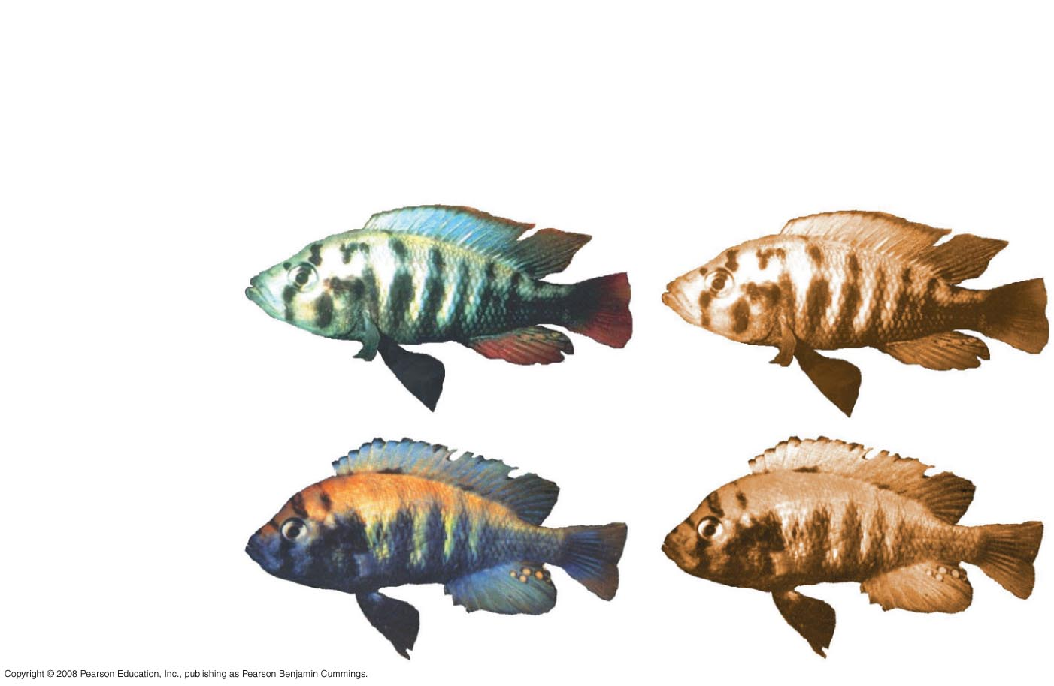
Hypothesis: Sexual selection has contributed to speciation in Lake Victoria
EXPERIMENT: Assess mate choice of females of 2 closely related species of cichlids under different lighting conditions
Monochromatic
orange light
Normal light
P.
pundamilia
P. nyererei
Fig. 24-12

Slide 25
Results:
under normal light, females strongly preferred males of their own species
under orange light, breeding was random
hybrids were viable and fertile
Conclusion:
in Lake Victoria, sexual selection acts as a prezygotic reproductive barrier between species
divergence of species was relatively recent based on viability of hybrid offspring

Slide 26
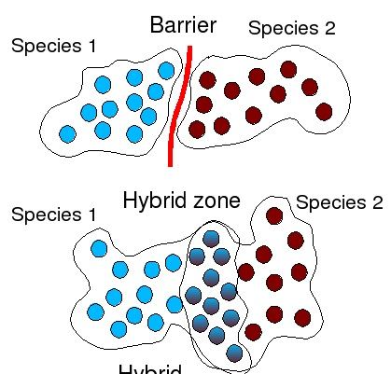
When allopatric species come back into contact and mate, a hybrid zone may form

Slide 27
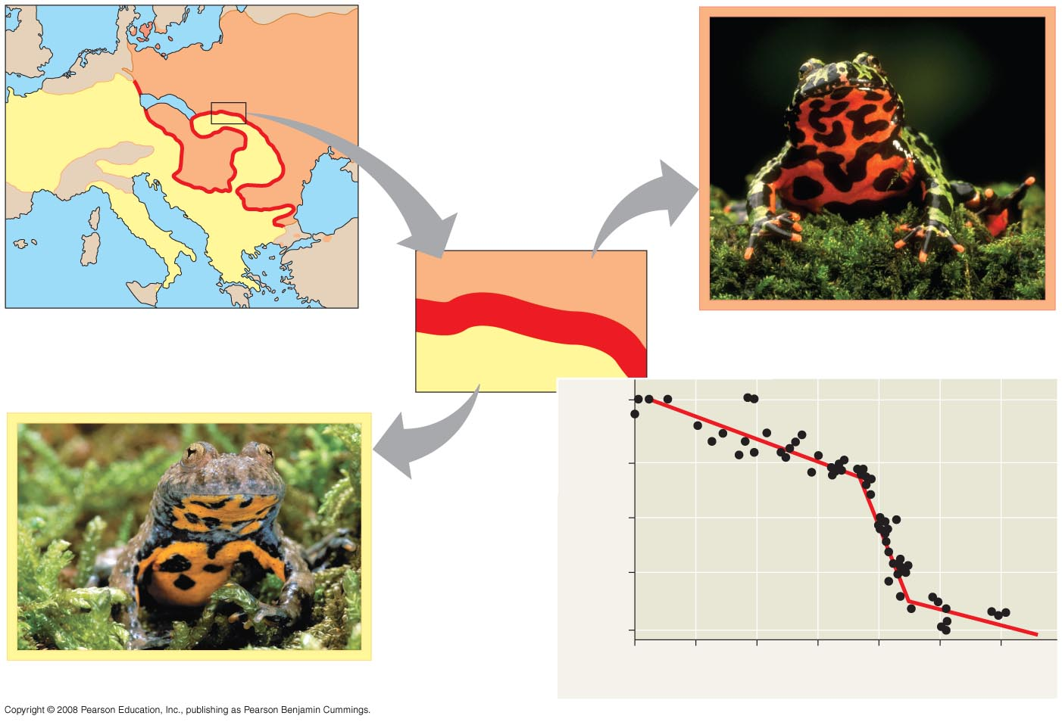
Two species of toads form a hybrid zone across Europe/Asia
Fig. 24-13
EUROPE
Fire-bellied
toad range
Hybrid zone
Fire-bellied toad,
Bombina bombina
Yellow-bellied
toad range
Yellow-bellied toad,
Bombina variegata
0.99
zone is approx 10 km wide
there are no geographic barriers
0.9
Allele frequency (log scale)
0.5
0.1
Why do hybrids not spread into parent populations?
0.01
40
30
20
10
0
10
20
Distance from hybrid zone center (km)

Slide 28
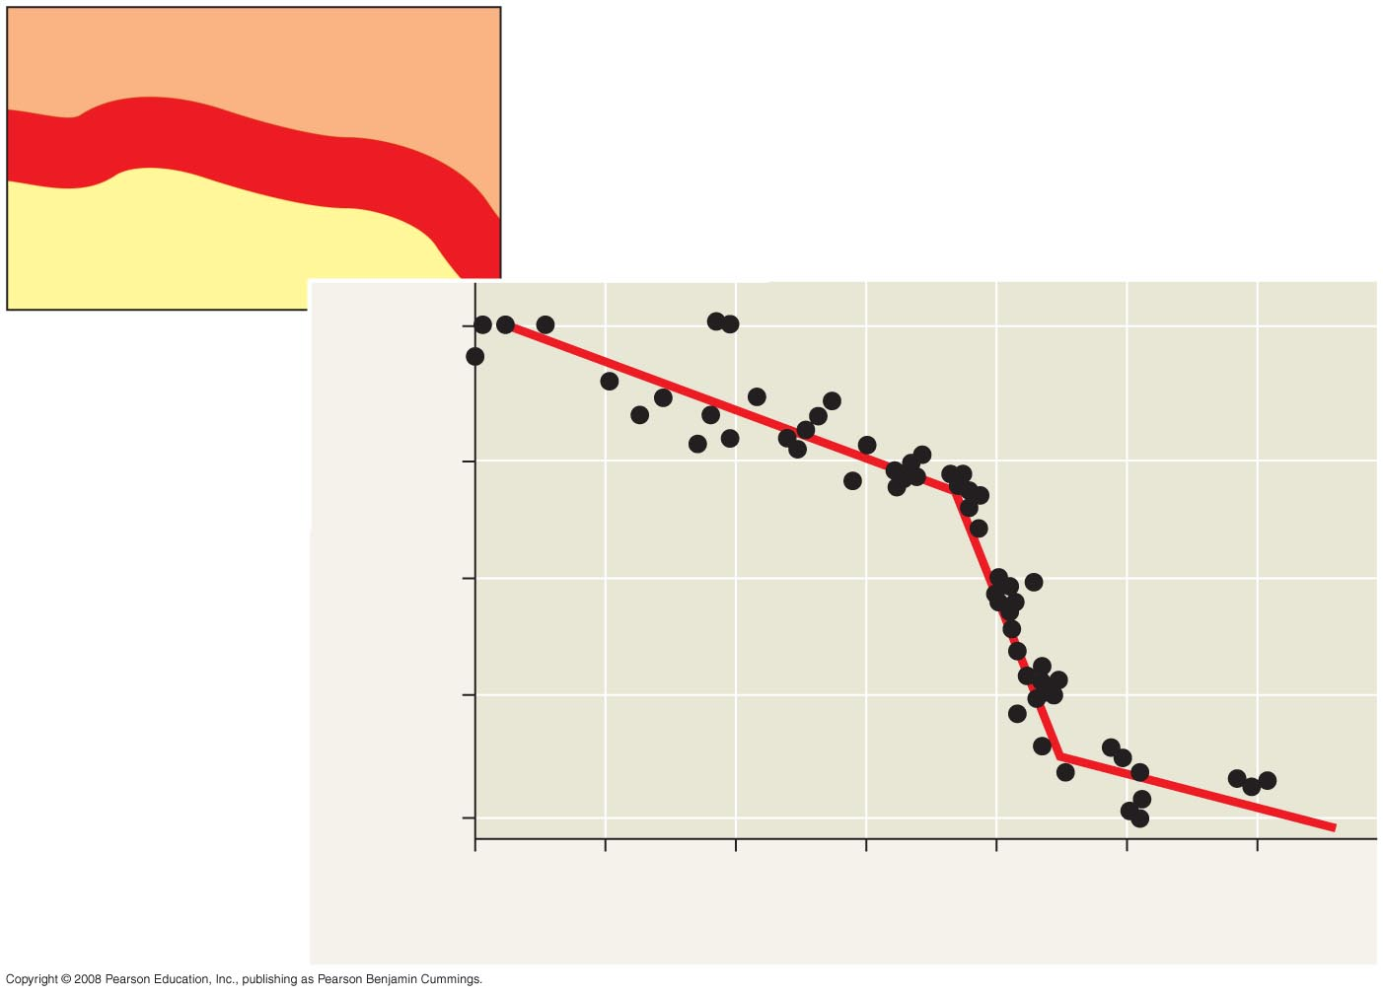
Allele frequencies demonstrate a lack of gene flow through hybrid zone
Fire-bellied
toad range
Hybrid zone
Yellow-bellied
toad range
Yellow-bellied toad allele frequency
0.99
0.9
Allele frequency (log scale)
0.5
0.1
0.01
40
30
20
10
0
10
20
Distance from hybrid zone center (km)

Slide 29
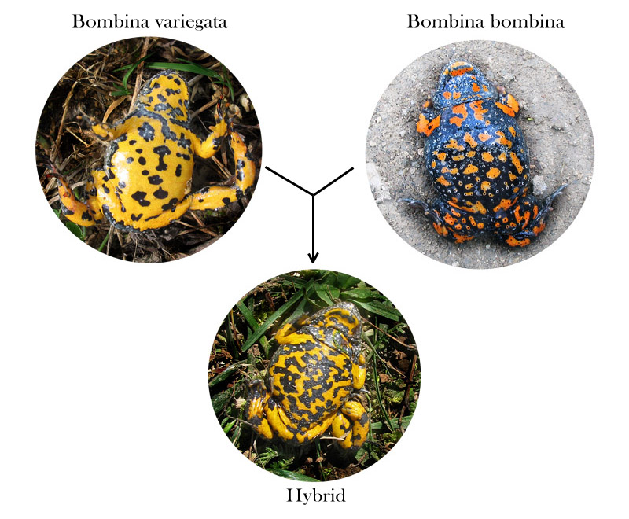
Bombina hybrids have increased embryonic mortality and reduced survival, restricting their spread from hybrid zone

Slide 30
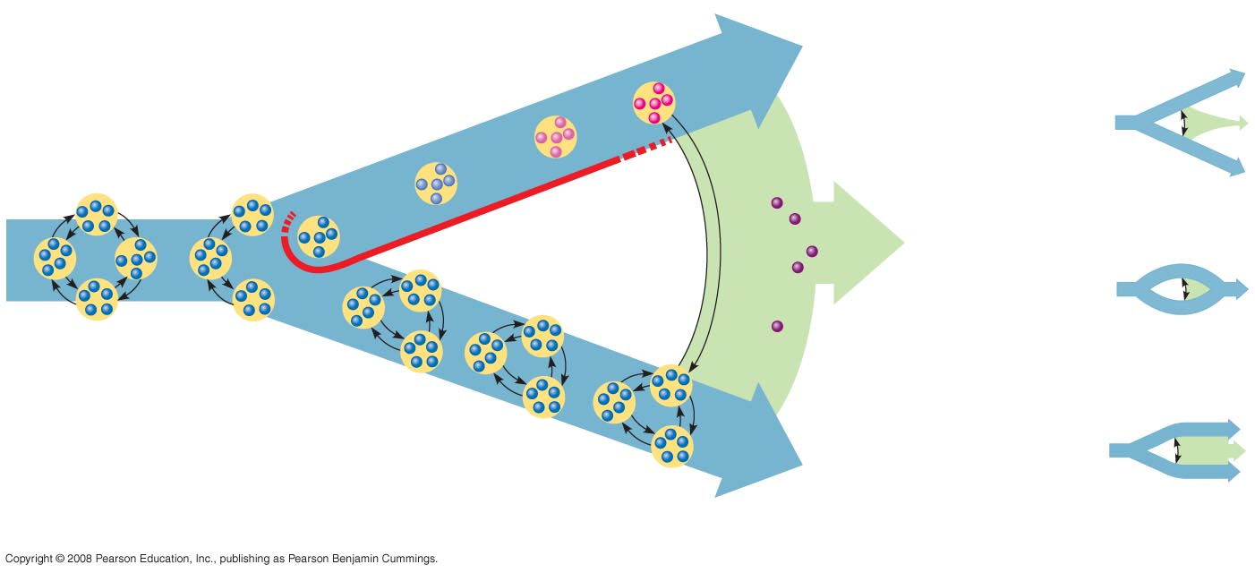
Several different outcomes are possible over time at a hybrid zone
Isolated population
diverges
Possible
outcomes:
Hybrid
zone
Reinforcement
OR
Fusion
Gene flow
Hybrid
OR
Barrier to
gene flow
Population
(five individuals
are shown)
Stability
Reinforcement : strengthen barriers, fewer hybrids
Fusion: weakening of barriers
Stability: continue to produce hybrids
Fig. 24-14-4

Slide 31
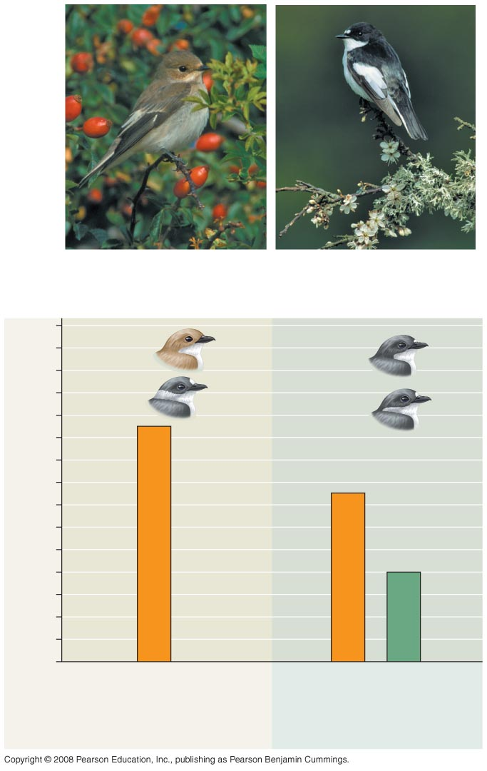
Mate preference is much stronger in sympatric vs. allopatric species of flycatcher to reduce the production of unfit hybrids
REINFORCEMENT
Sympatric male
pied flycatcher
Allopatric male
pied flycatcher
28
Pied flycatchers
24
Collared flycatchers
20
16
Number of females
12
8
Species are usually separated geographically
4
(none)
0
Females mating
with males from:
Own
species
Other
species
Own
species
Other
species
Fig. 24-15
Sympatric males
Allopatric males

Slide 32
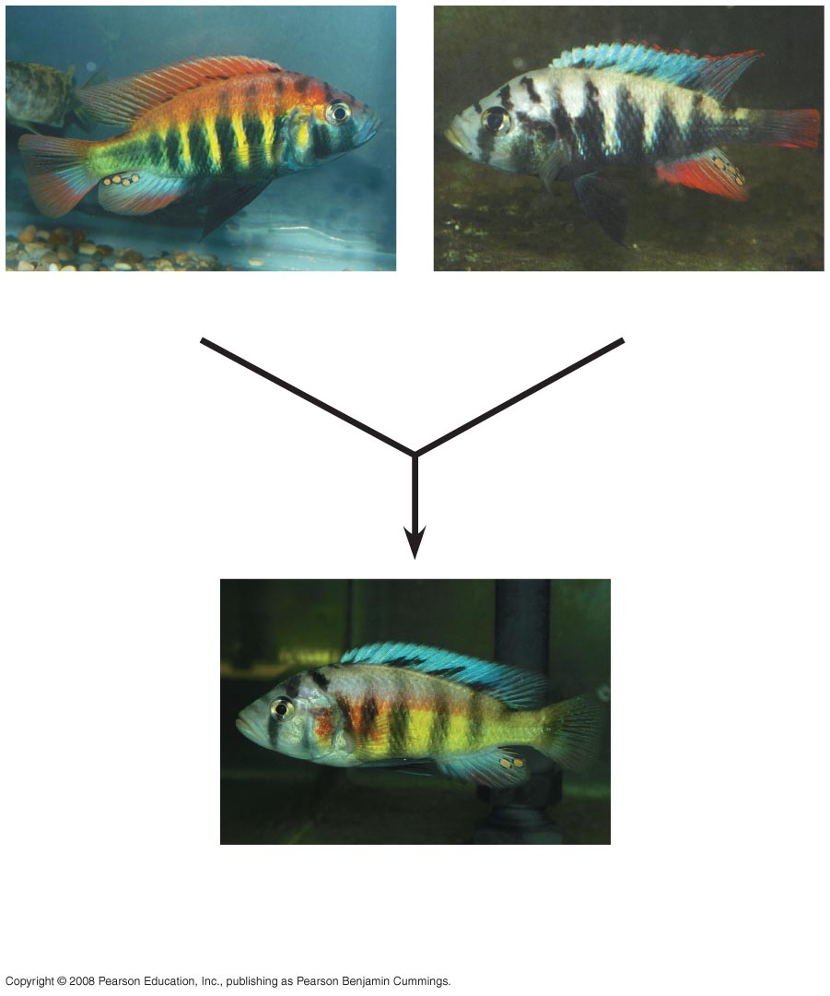
Ex: Pollution may be reducing sexual selection in the cichlids of Lake Victoria
FUSION
Pundamilia nyererei
Pundamilia pundamilia
Pundamilia “turbid water,”
hybrid offspring from a location
with turbid water
Fig. 24-16

Slide 33
Do the forces that lead to speciation events occur at a consistent rate over evolutionary time?
NO

Slide 34
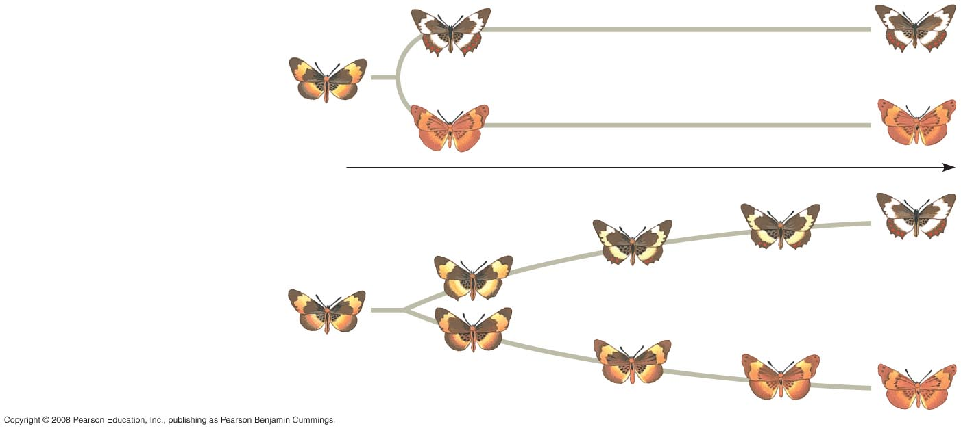
The fossil record suggests that species can change gradually over time or experience periods of rapid change
punctuated equilibrium:
(a) Punctuated pattern
Time
(b) Gradual pattern
Fig. 24-17

Slide 35
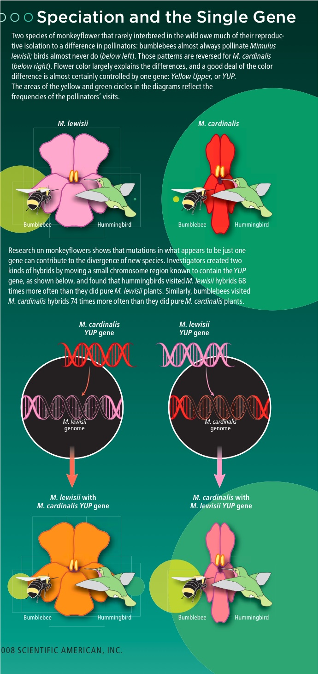
The basis of speciation is changes in genes
the genetics of speciation must be considered on a case-by-case basis, but some examples have been found in which a single gene mutation is responsible

